Slide 1
P-168 Project
Group 6
Team Members
Miss Punami Chowdary Dukkipati
Mr. Arun Babu Chacko
Mohit
Mr.Kunduru Viswanatha Reddy
Mr. Khairnar Tushar Manik
Mr. Kambare Vishal Somnath
Ali Abdo Ali Qasem Humadi
Dr. Sharath B R
Project Mentor :-Madi Shetty Rajashekar

Slide 2
Business Problem
Objective:
Make a car price predictor model using data scraped from cars24.com
Create a live dashboard to display the collected data

Slide 3
Project Flow
Data Cleaning:
Removed units and symbols
Dropped irrelevant columns
EDA/ Visualization:
Checking for null values
Checking for duplicates
Outliers
Dashboard:
Power BI Dashboard
PyWedge Dashboard
Model Building:
Deployed 3 different regression models
Model Deployment:
Decision Tree Model Deployed in Flask

Slide 4
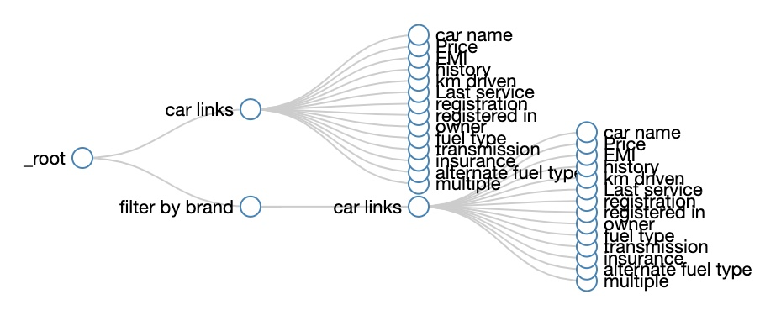
Data Collection - Web Scraper Extension
Notes:
Collected 4000 records of data
After cleaning - 2880 records

Slide 5
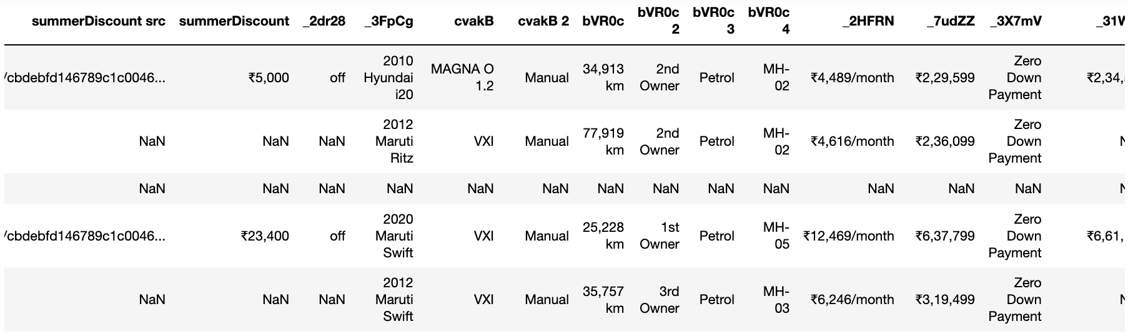
Preprocessed Data
4456 rows × 19 columns
Notes:
4456 rows × 19 columns
Contained URLs, units, unwanted strings

Slide 6
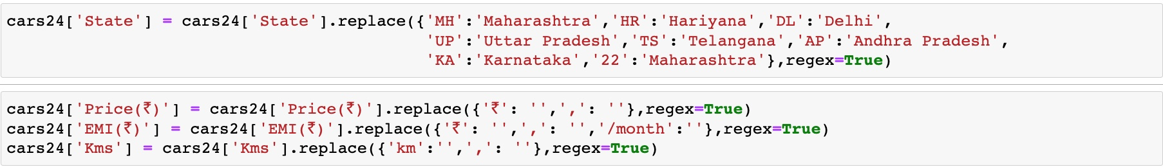
EDA
Removed units (₹, km, /month)
Removed unwanted strings
Removed URLs
Dropped irrelevant columns
Dropped 1375 duplicate rows
Dropped 200 records with null values

Slide 7
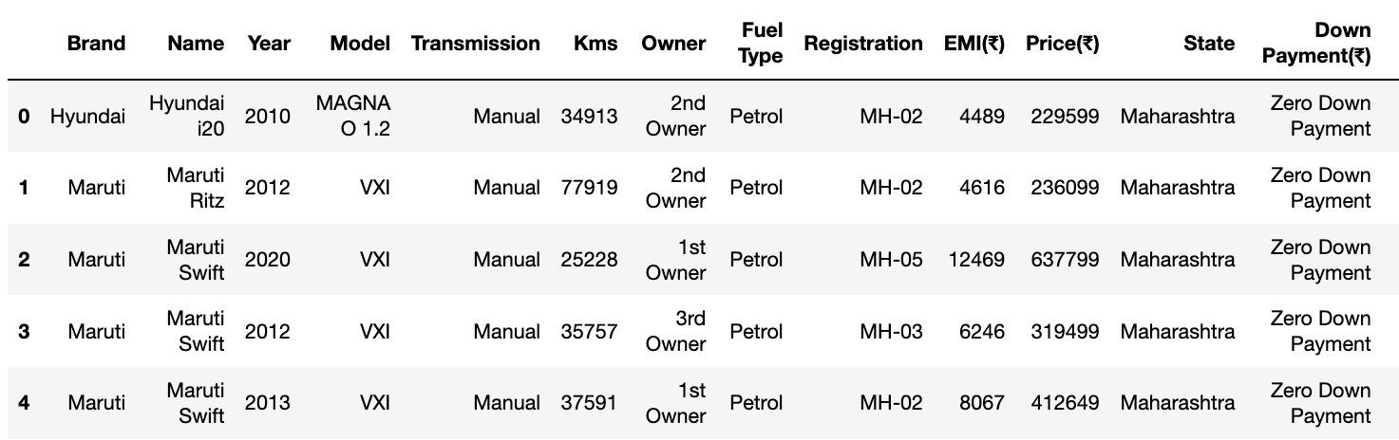
Data Set Details (After EDA)
2880 rows × 13 columns
Notes:
2880 records
13 Columns

Slide 8
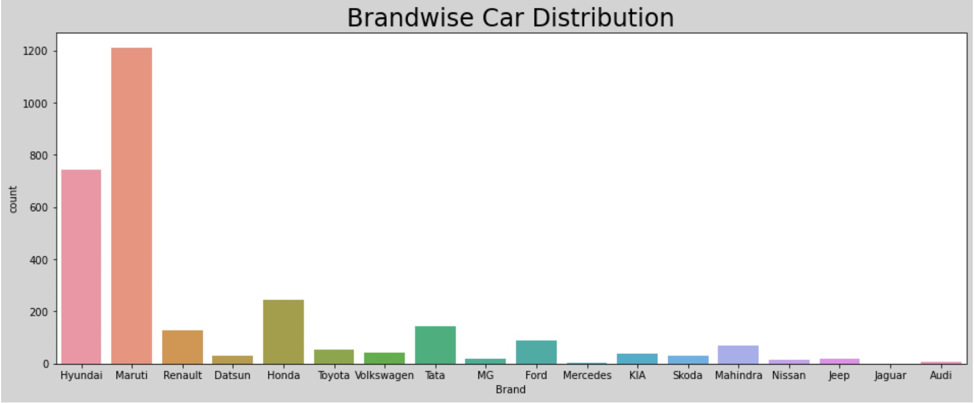

Slide 9
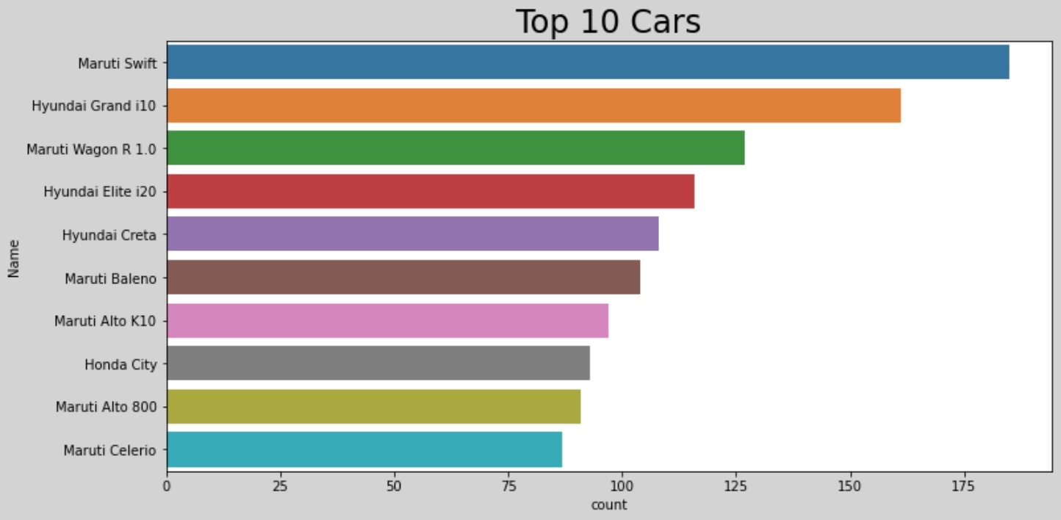

Slide 10
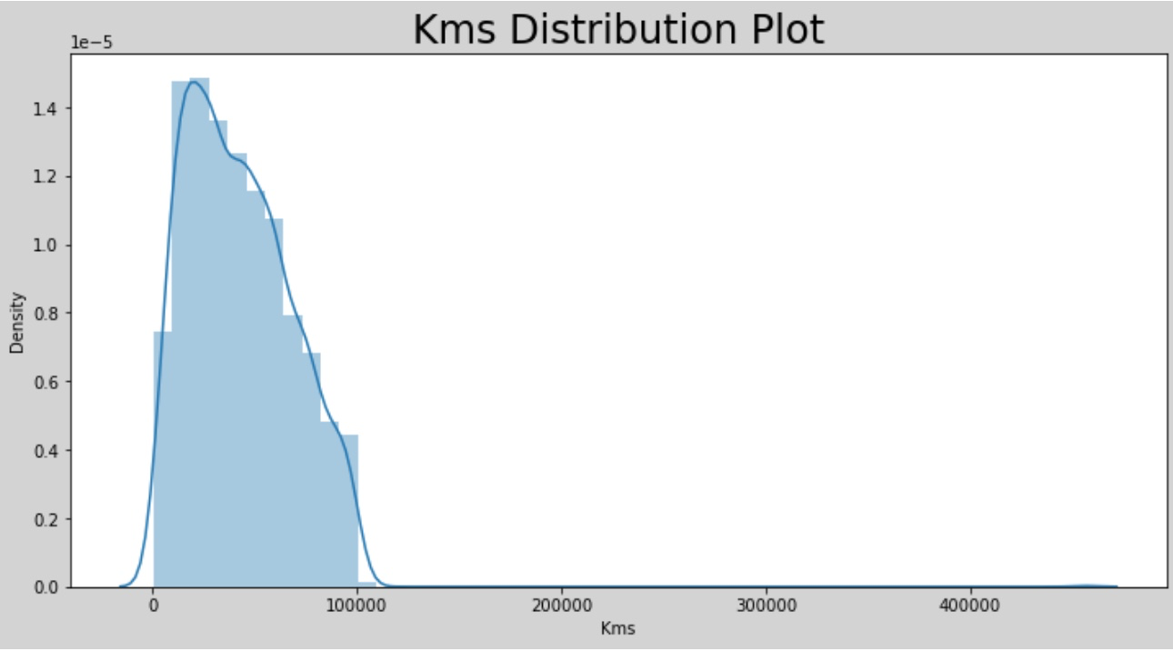

Slide 11
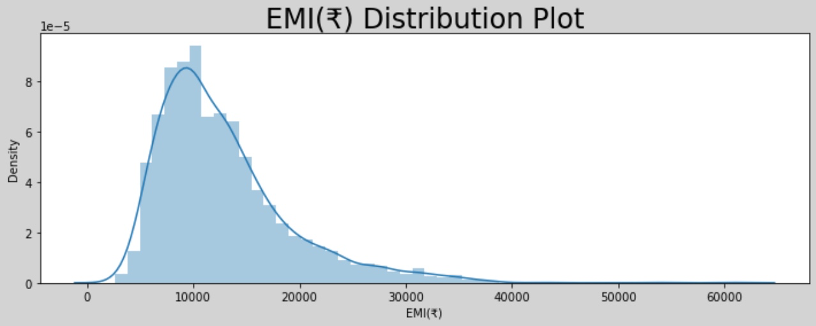

Slide 12
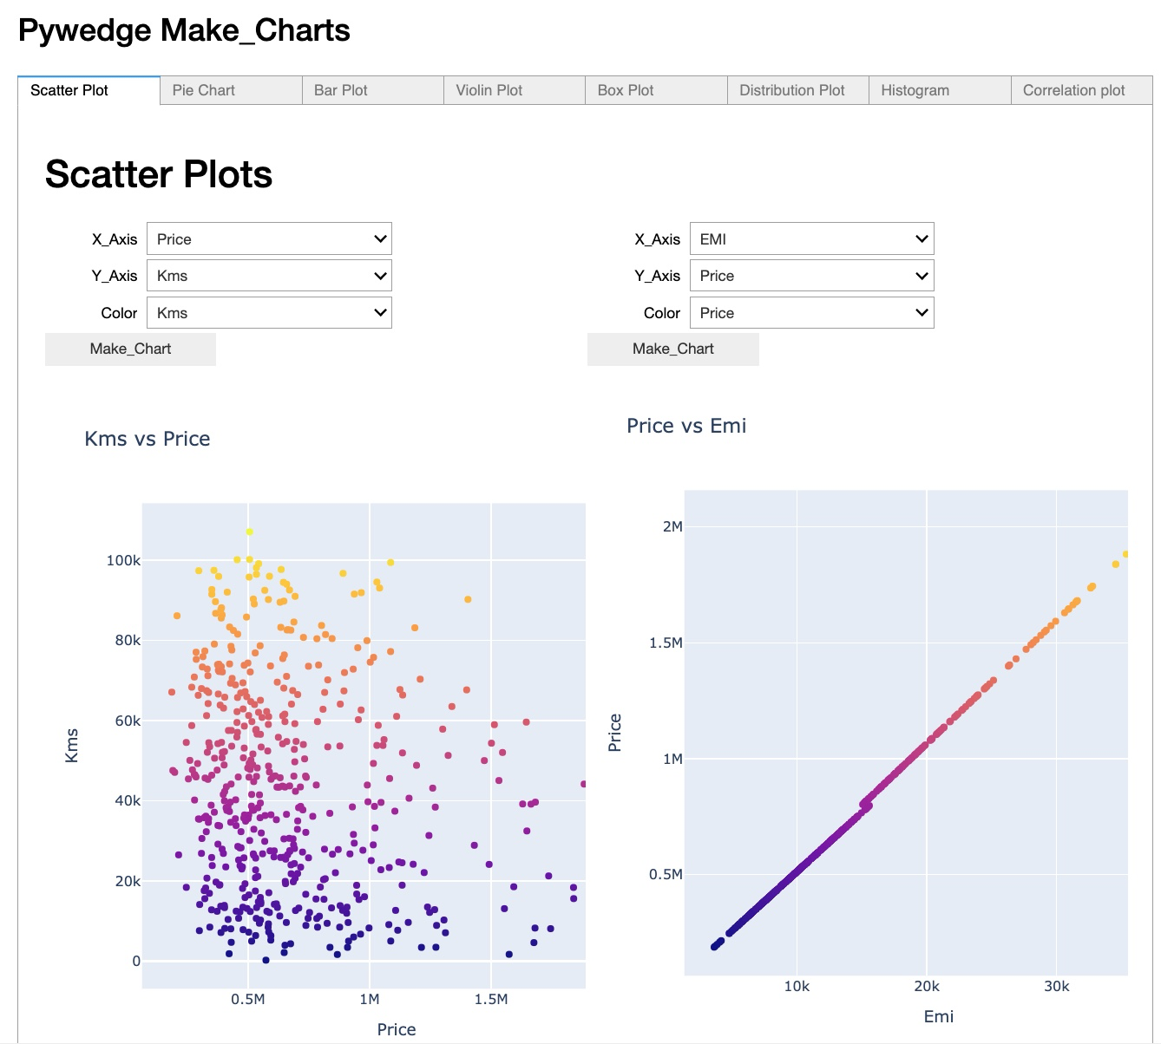
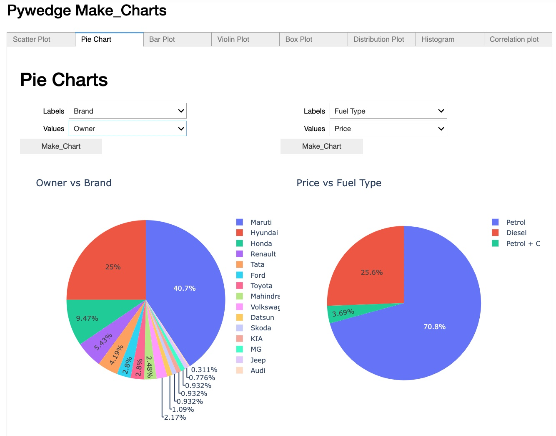
PyWedge Dashboard

Slide 13
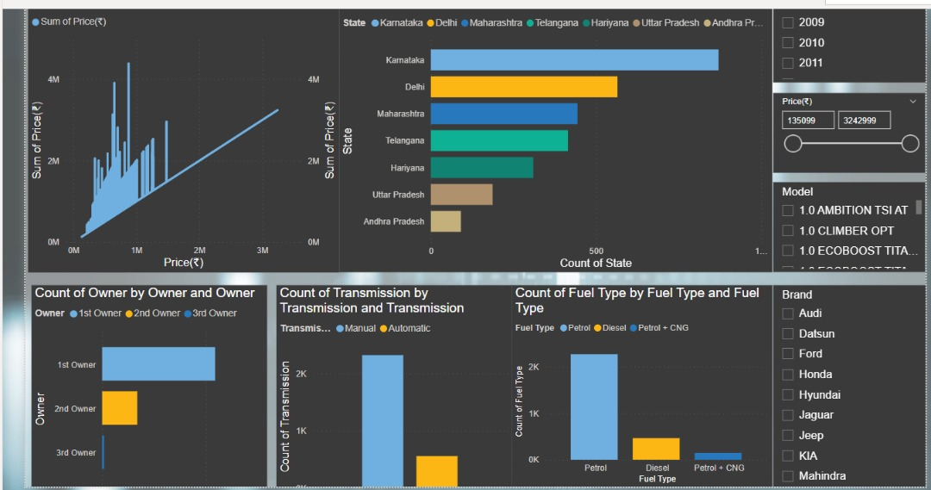
PowerBI Dashboard

Slide 14
Models Used
Decision Tree
SVM
Linear Regression

Slide 15
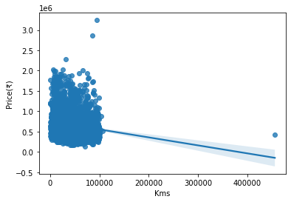
Model Building
Model:-
Linear Regression :-
Linear regression was not fit for this model by seeing this graph

Slide 16
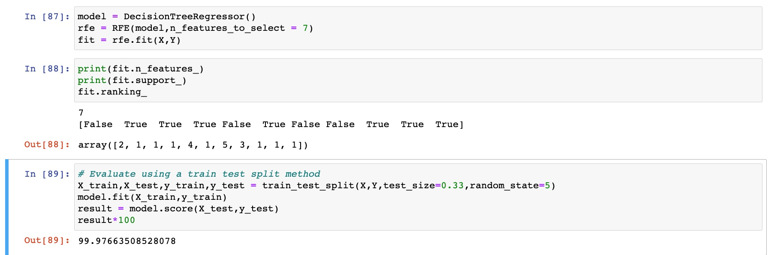
Decision Tree - Final Model

Slide 17
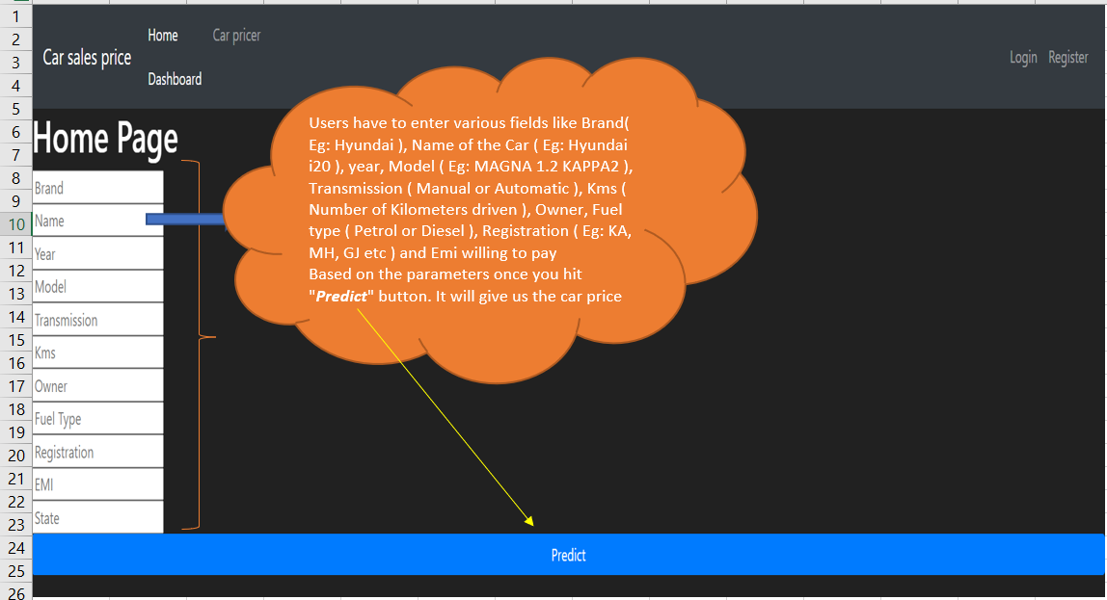
Model Deployment

Slide 18
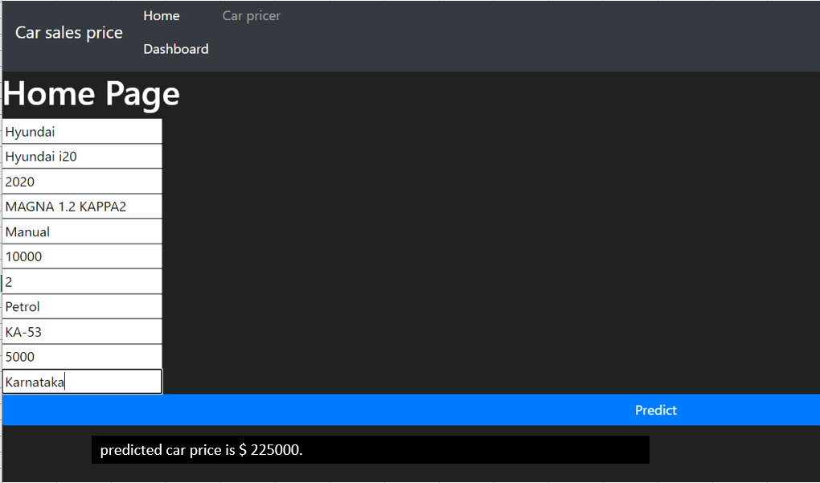
Predicted Car Price

Slide 19
Challenges
1. Scrubbing the data from the car24.com with the help of APPS
2. Sorting the data
3.Linear regression will not be a good model for the given dataset of the data frame .

Slide 20
Thank you

